Slide 1
Mission
Do we all have a
mission in life?

Slide 2
Explore
Inspirational communities.

Slide 3
What does the word inspirational mean?
What does the word community mean?

Slide 4
A lady with a mission
In 1959, a Dutch student called Elly Jansen was studying theology in London. She was already a nurse and had studied psychology (the science concerned with how the human mind works and why we behave as we do).

Slide 5
While she was studying, she realised that many people, who had finished their stay in a psychiatric hospital, had nowhere to go except to return to the same lonely place they were in before they needed to go to hospital. These people were depressed, anxious or distressed in some way. They had found it difficult to cope in the busy, complex world. Elly thought they needed a halfway house between leaving hospital and coping on their own. They needed affection and to know they were valued and able to help themselves and others.

Slide 6
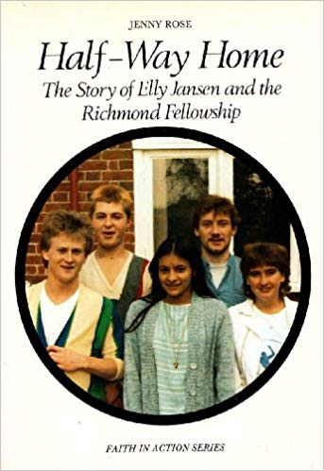
So, Elly rented a house in Richmond. At first, there were a lot of difficulties, but Elly learned from her mistakes. It was hard work learning to run a community, like this. It soon became clear that, for the house to run smoothly, there must be regular meetings to sort out problems.

Slide 7
The house in Richmond was one of the first places to provide fellowship, support and a sense of self-respect and responsibility for these residents.
Everyone shared the work and tried to be considerate to one another, by arriving on time for meals.

Slide 8
In 1965, six years after she had begun her work, Elly bought a large house in London, which became the Fellowship’s headquarters. Soon there were eight houses in London alone. In the following years, many more were set up in Britain and abroad. The basis of the Richmond Fellowship’s work is respect for the individual. Elly believes it’s important to give everyone dignity.

Slide 9
Reflection
Everyone has a mission. It may be big or small, but it is something that you are called to do, which only you can do.

Slide 10
Blessed John Newman wrote some famous lines about everyone having a special task in life:
"It may seem to be ordinary and simple, but if it is done in love for God and our neighbour, it is a definite task or mission which is special to each person."

Slide 11
God has created me
To do Him some definite service.
He has committed some work to me
Which he has not committed to another.
I have my mission.
The Richmond Fellowship

Slide 12
Some Key Questions
What was Elly Jansen’s inspiration for her mission?
What did she do and why?
How did she do it?
What is the purpose of the Richmond Fellowship?
How did it come into existence?
How does the community/group function?
What do you think are the demands and joys of such dedication?
How do you think you can discover your mission?

Slide 13
ACTIVITY
Research one of the following charities and find out which inspirational person founded the charity and why.
Save the Children – search ‘Save the Children history’.
Barnardo’s – search ‘Barnardo’s history’.
The Donkey Sanctuary – search ‘The Donkey Sanctuary our story’
The Jane Goodall Institute – ‘Jane Goodall charity our story’

