Slide 1
11.01.21
LO: Count in ¹⁄₄s, ¹⁄₃s, ¹⁄₈s and ¹⁄₁₀s

Slide 2
Let’s count along the line... one third, two thirds, ONE, one and one third, one and two thirds, TWO....
This number line goes up in thirds.
²/₃
1²/₃
2¹/₃
3²/₃
4¹/₃
Write the number the arrow points to on your whiteboards.

Slide 3
Let’s count along the
line to five. One quarter, two quarters, three quarters, ONE, one and one quarter….
This number line goes up in quarters.
¹/₂
1¹/₂
2¹/₂
3¹/₂
4¹/₂
²/₄
1²/₄
Let’s count to five using quarters and halves.
One quarter, one half, three quarters, ONE, one and a quarter, one and a half, one and three quarters…
What’s another way of saying two quarters?
One and two quarters? Two and two quarters…

Slide 4
Let’s count along the
line to two. One tenth, two tenths, three tenths……ONE, one and a tenth….
This number line goes up in tenths.
¹/₅
²/₅
¹/₂
³/₅
⁴/₅
²/₁₀
⁴/₁₀
⁵/₁₀
⁶/₁₀
⁸/₁₀
Let’s count along in tenths from 0 to 1 using the simplest equivalent fractions.
Let’s mark on equivalent fractions.
Now from 1 to 2 – the pattern will be the same..
Notes:
Children can now go on to do differentiated GROUP ACTIVITIES. You can find Hamilton’s group activities in this unit’s TEACHING AND GROUP ACTIVITIES download on our website.
WT: Marking on and counting fractions on a number line.
ARE: Marking on and counting fractions on a number line and comparing them.
GD: Marking on and counting fractions on a number line (harder fractions).

Slide 5
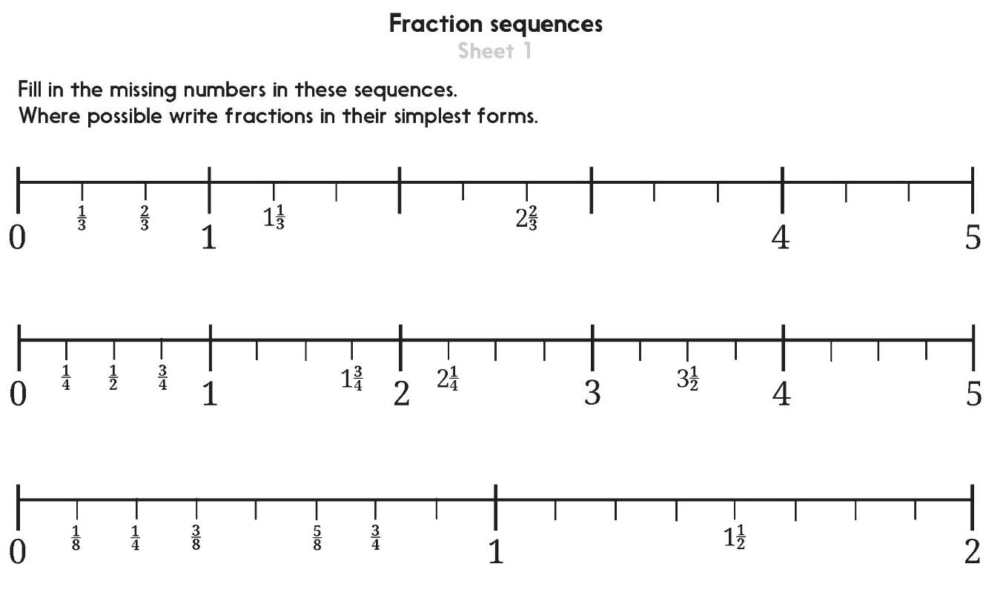

Slide 6
Problem solving and reasoning questions
Bea counts in quarters starting at one quarter. She says five numbers then stops. What number should she say next?
Fill in the missing fractions:
1¹/₂, 2, 2¹/₂, 3, , 4, , 5
4, 3³/₄, 3¹/₂, , 3, , 2¹/₂
⁸/₁₀, ⁹/₁₀, , , 1²/₁₀
Write all the fraction facts for tenths of 60.
¹/₁₀ of 60 = ²/₁₀ of 60 = etc. to ¹⁰/₁₀
Use this bar diagram
to help find answers
¹/₈ of 48 = (ii) ³/₈ of 48 = (iii) ⁷/₈ of 48 =
Is ¹/₁₀ of 50 the same as ¹/₅ of 100?
48

Slide 7
Problem solving and reasoning questions answers
Bea counts in quarters starting at one quarter. She says five numbers then stops. What number should she say next? 1¹/₂ (or 1²/₄)
Check on a number line divided into quarters, also useful for next question if children are struggling.
Fill in the missing fractions: 1¹/₂, 2, 2¹/₂, 3, 3¹/₂ , 4, 4¹/₂ , 5
4, 3³/₄, 3¹/₂, 3¹/₄ , 3, 2³/₄, 2¹/₂
⁸/_{10,} ⁹/_{10,} 1 , 1¹/_{10 ,} 1²/₁₀
Write all the fraction facts for tenths of 60.
¹/₁₀ of 60 = 6
²/₁₀ of 60 = 12
etc. (18, 24, 30, 36, 42, 48, 54) to ¹⁰/₁₀ = 60 Do children make the connection to 6x table facts?
Use this bar diagram
to help find answers
¹/₈ of 48 = 6
(ii) ³/₈ of 48 = 18
(iii) ⁷/₈ of 48 = 42
Is ¹/₁₀ of 50 the same as ¹/₅ of 100? No, since ¹/₁₀ of 50 = 50 ÷ 10 = 5 and ¹/₅ of 100 = 100 ÷ 5 = 20.
48
6 | 6 | 6 | 6 | 6 | 6 | 6 | 6

