Slide 1
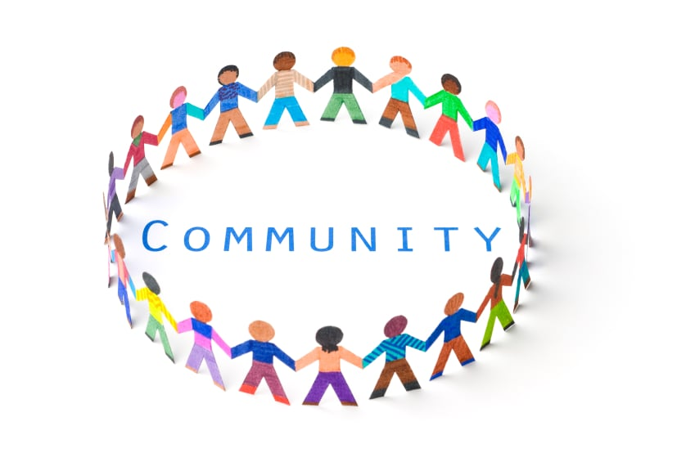
Tuesday 5th January 2021
LO: I can think about my local community

Slide 2
Now read the attached story.

Slide 3
Let's think about what we've read:
What do you think happened next in the story?
Why was the Castleford estate a happy place to live?
Why do you think Sister Christine helped the Castleford community?
What do you think is meant by the word community?
What are the advantages of being part of a community?
What are the demands of being part of a community?
What do you think could cause the breakdown of a community?
What helps to build up community?

Slide 4
What are some of the communities you belong to?
What are some of the jobs people carry out in the
community?
What would the commitment to that job mean?
Why would people do those jobs?

Slide 5
Today's activity:
Fill in the word document attached.
An example:
The community Jobs people do Why they do it
School Teacher To help children learn

