Slide 1
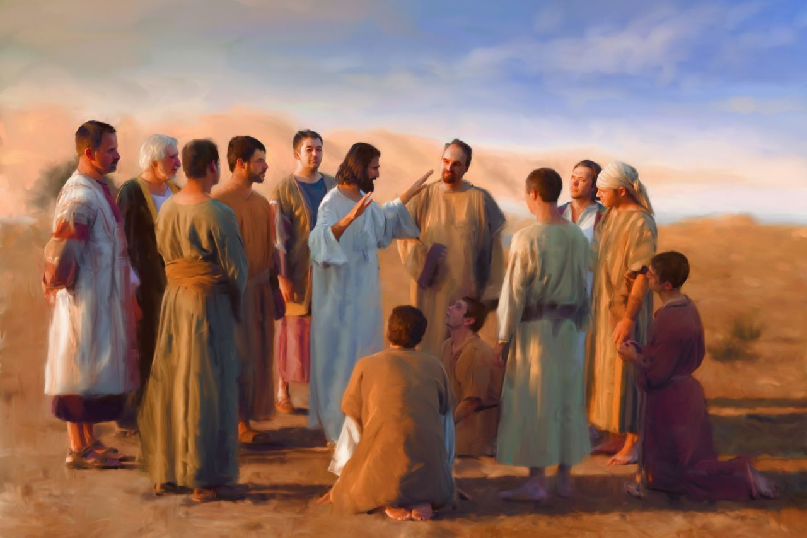
Tuesday 12th January 2021
LO: To write a code of conduct

Slide 3
I Have Chosen You
1) Simon (whom Jesus called Peter – the rock)
2) James and
3) John, the sons of Zebedee (whom Jesus called sons of thunder)
4) Andrew
5) Philip
6) Bartholomew
7) Matthew
8) Thomas
9) James the son of Alphaeus
10) Thaddaeus
11) Simon the Zealot
Judas Iscariot
(he would, one day,
betray Jesus)
Jesus left the crowds behind and went up onto the mountain. He sent for some of his friends.
When they came he chose twelve of them to be his special friends and to help him in his work.
“I have chosen you to be my apostles,” he said, “I want to send you out to tell everyone the Good News of God’s love.”
These are the names of the twelve:
(Based on Mark 3:13-19)
God’s Story 3

Slide 5
Let’s reflect on this...
How do you think the apostles felt when Jesus chose them to help him in his work?
Why do you think he chose people to help him?
What do you think the Good News is?

Slide 6
Your task
To design a ‘Code of Conduct’ of how to live as an ‘apostle’ of Jesus, giving reasons for their choices.
My Code of Conduct
To listen to my parents and teachers.
Jesus listened to his parents, Mary and Joseph as well as his religious teachers.
To pray daily and go to Church.
Praying brings us closer to God and being part
of the Church community is an important part of being a Catholic.

