Slide 1
13.01.21
LO: To find unit and non-unit fractions of amounts

Slide 2
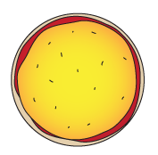
This pizza has been cut into 8 equal slices.
The chef shares toppings equally.
If there are 16 pieces of salami how many should go on each slice?
Each slice would have ¹/₈ of the salami.
We can find ¹/₈ of 16 by dividing 16 by 8.
2 pieces for each slice!
16 ÷ 8 = ?

Slide 3
We can make a list of fraction facts for eighths of 16...
¹/₈ of 16 = 2
²/₈ of 16 = 4
³/₈ of 16 =
¹/₈ of 16 = 2
²/₈ of 16 = 4
³/₈ of 16 = 6
⁴/₈ of 16 = 8
⁵/₈ of 16 = 10
⁶/₈ of 16 = 12
⁷/₈ of 16 = 14
⁸/₈ of 16 = 16
Let’s check.
Continue the list on your whiteboards.
Who got all those?

Slide 4
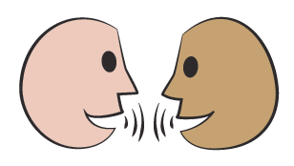
16
2
2
2
2
2
2
2
2
We can also show fractions of 16 using a bar model. Each small bar represents ¹/₈ of the whole.
How can we use the bar model to find ³/₈ of 16 or ⁵/₈ of 16?
³/₈ of 16 will be
3 of the 2s. 3 × 2 = 6.
⁵/₈ of 16 will be
5 of the 2s. 5 × 2 = 10.

Slide 5
If there are 24 pieces of tomato how many should go on each slice?
We can find ¹/₈ of 24 by dividing 24 by 8.
24 ÷ 8 = ?
3 pieces on each slice!

Slide 6
24
3
3
3
3
3
3
3
3
Let’s show that on a bar model.
Use the bar model to find ³/₈ of 24 and ⁵/₈ of 24.
That’s easier than drawing a pizza!
Notes:
Today would be a great day to use the problem-solving investigation – Foodie Fractions – as the group activity, which you can find on the next slides and in this unit’s IN-DEPTH INVESTIGATION box on Hamilton’s website.
Alternatively, children can now go on to do differentiated GROUP ACTIVITIES. You can find Hamilton’s group activities in this unit’s TEACHING AND GROUP ACTIVITIES download on our website.
WT: Finding fractions of 24 using visual support.
ARE: Finding fractions of 24.
GD: Finding fractions of 24 and 36.

Slide 7
Investigation: Child Sheet

Slide 8
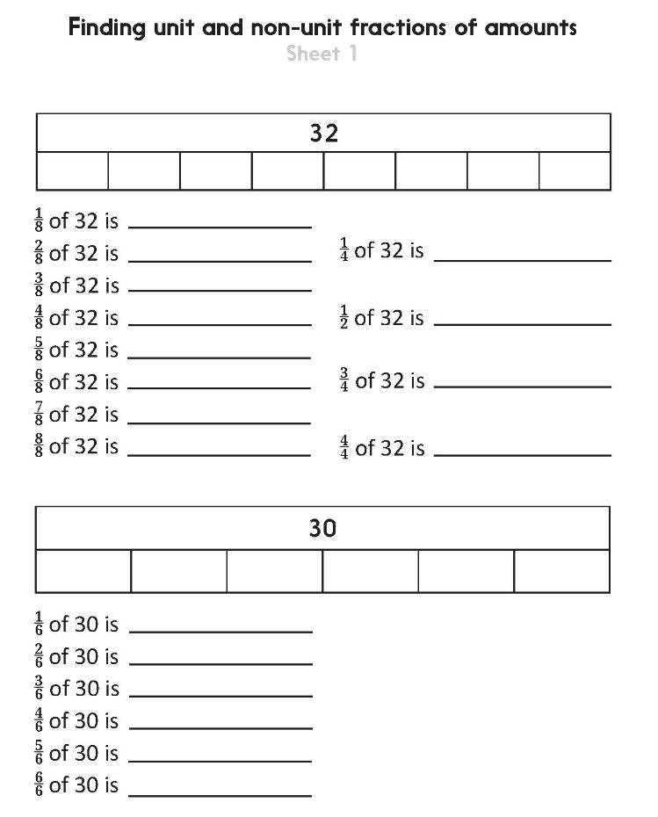
Challenge
Notes:
The Practice Sheet on this slide is suitable for most children.
You can download differentiated PRACTICE WORKSHEETS from Hamilton’s website in this unit’s PROCEDURAL FLUENCY box.
WT: Finding unit and non-unit fractions of amounts.
ARE: Finding unit and non-unit fractions of amounts.
GD: Finding unit and non-unit fractions of amounts and Challenge.

