Slide 1
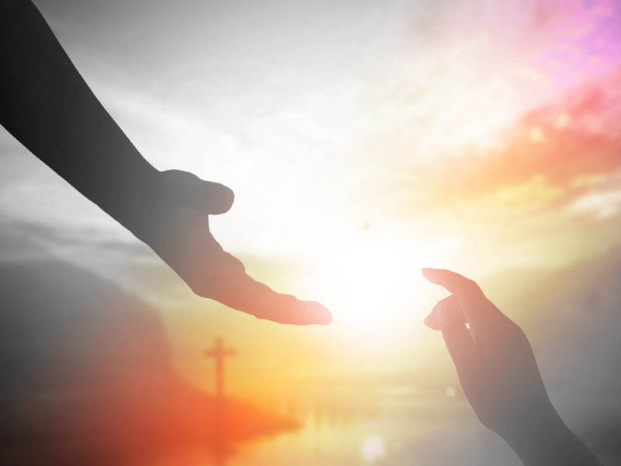
New topic - Called
October 2020

Slide 2
Time to reflect
Why were Abigail and Benjamin chosen?
What do you think of their different responses to being chosen?
Have you ever been chosen for something and said yes immediately? What were your reasons for saying yes?
Have you ever been chosen or called on for something and refused? What were your reasons?
Why is it difficult to make a response in some situations?
Do you sometimes have to give up something when you are chosen? E.g. if you are chosen for a sports team you may have to give up time for practices and matches.

Slide 3
Reflect on times you have been chosen or called on for something. Discuss and share your opinions about what happened, how you felt, any difficulties you had in accepting it, your response and the reasons for it.

