Slide 1
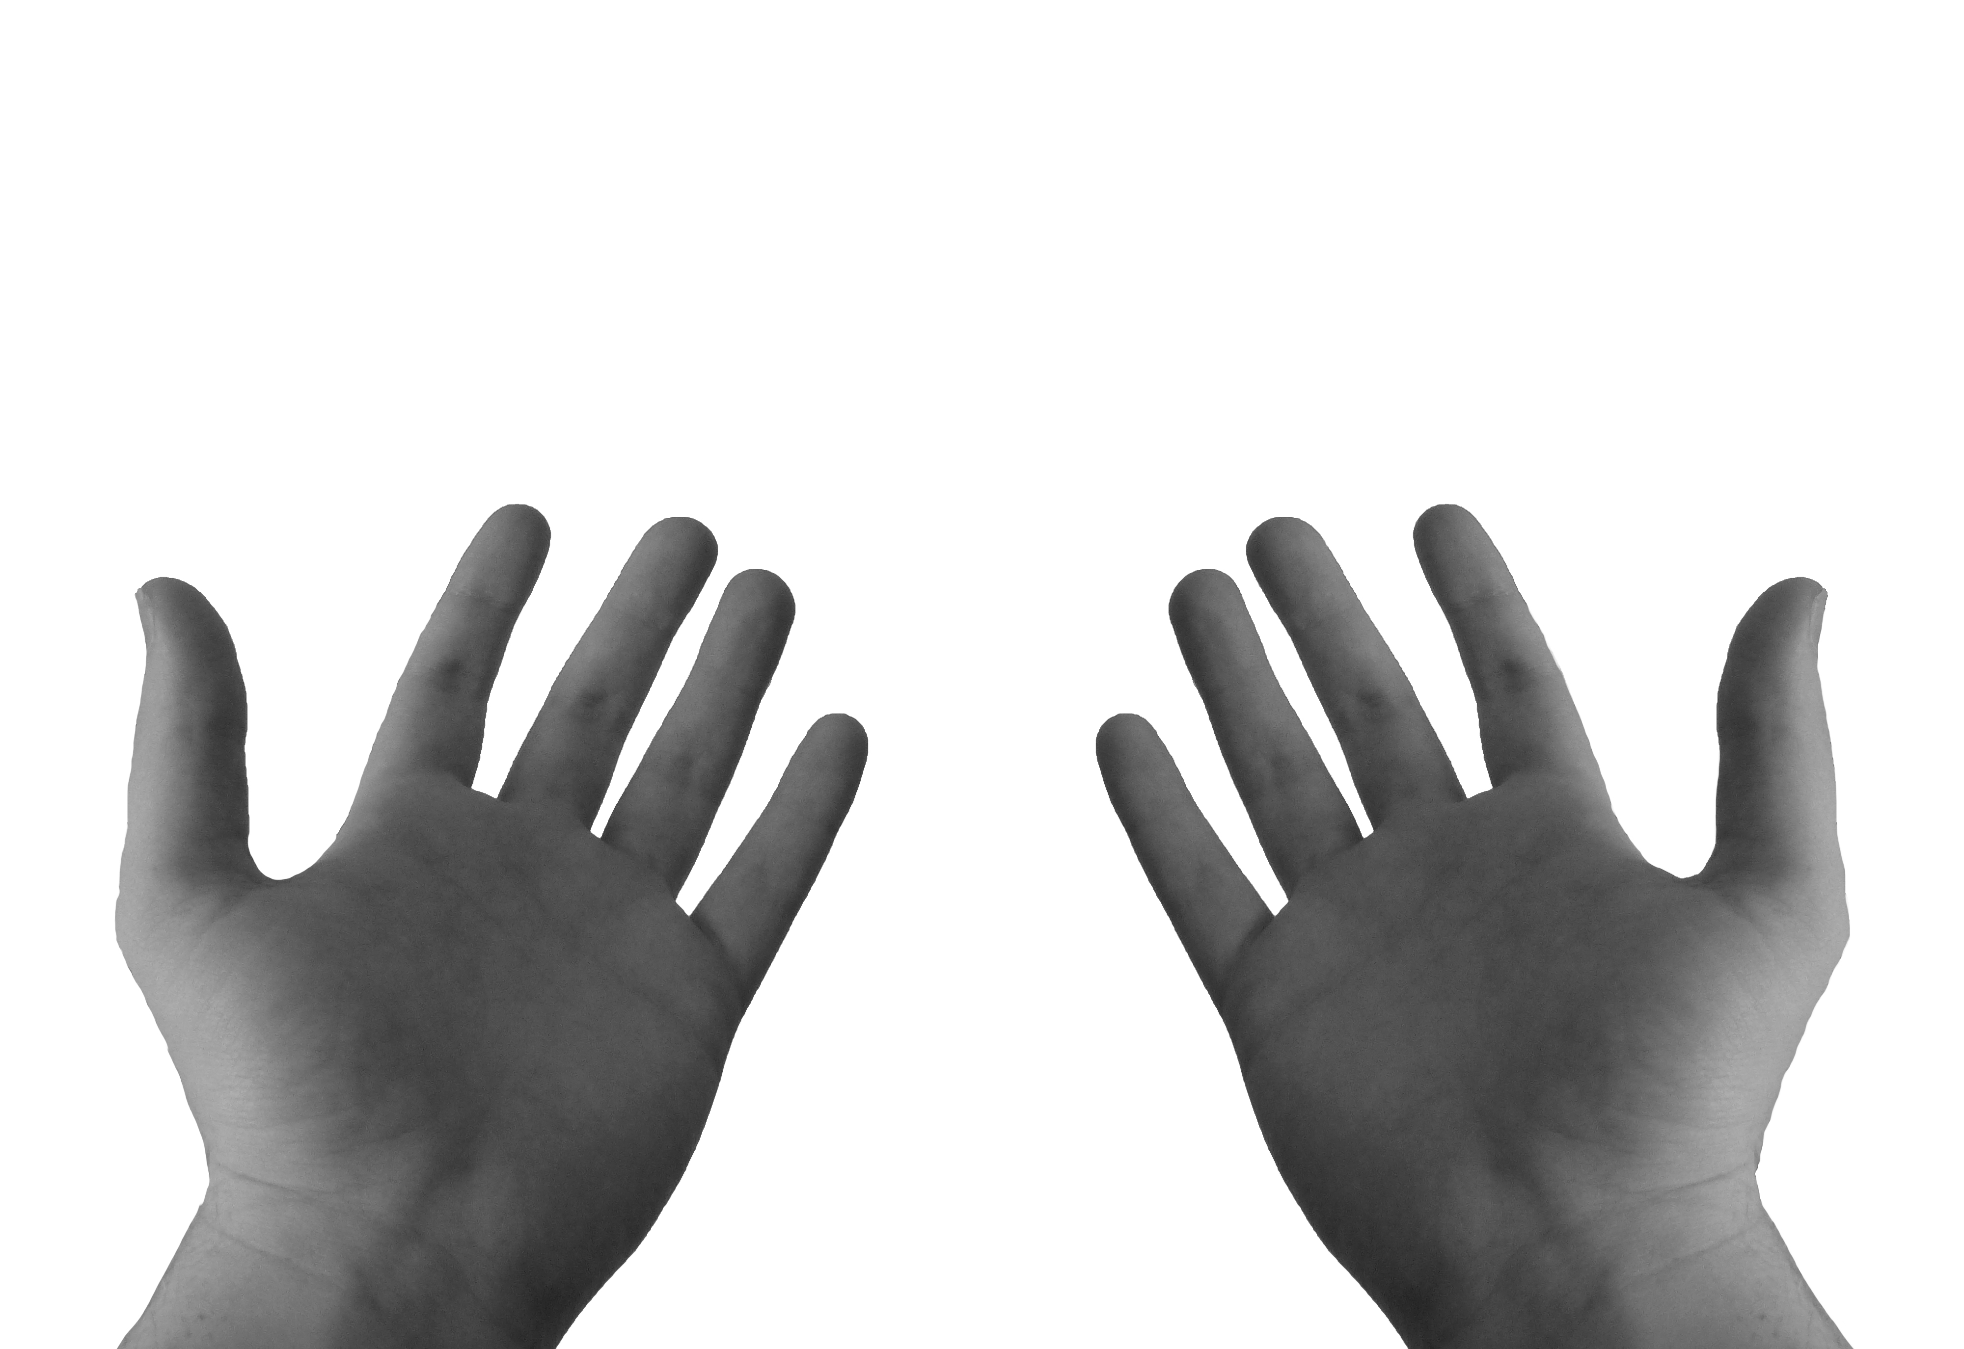
Sacrament Of Reconciliation
This means to think about the ways they have not followed Jesus’ way of love and kindness.
The priest welcomes the penitent, and they both make the Sign of the Cross.
The penitent confesses/tells the priest his/her sins.

Slide 2
The priest talks kindly to them, encourages them and asks them to do or say something to make up. This is called a penance.
The person then prays an act of sorrow, which includes the promise to try not to do the same again.
The priest says the words of forgiveness and absolution.
The priest says the words of forgiveness and absolution.

