Slide 1
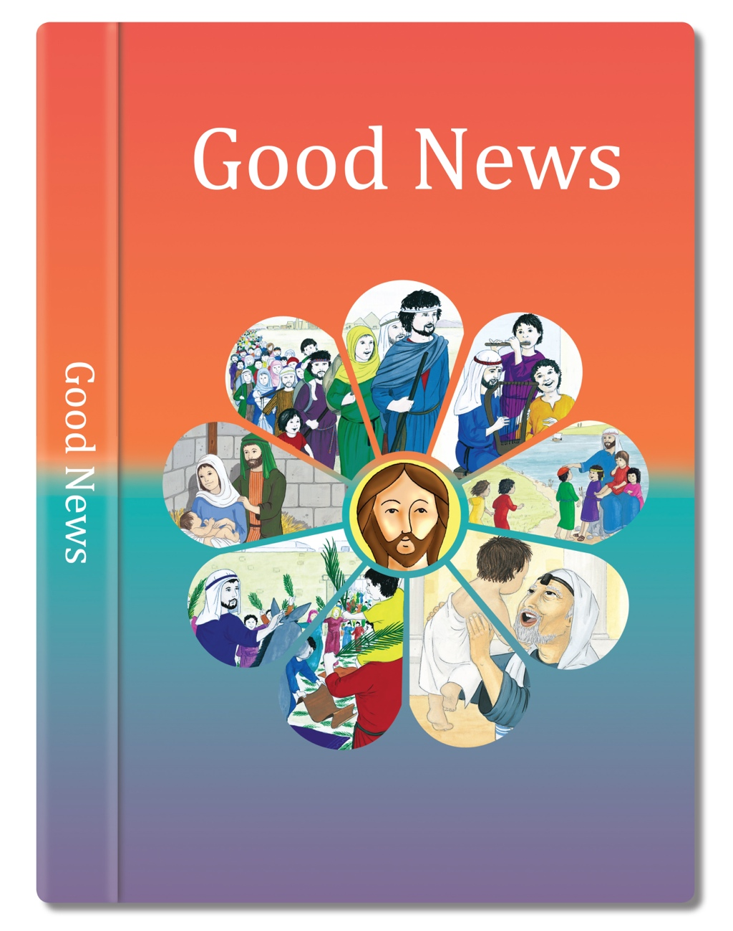

Slide 2
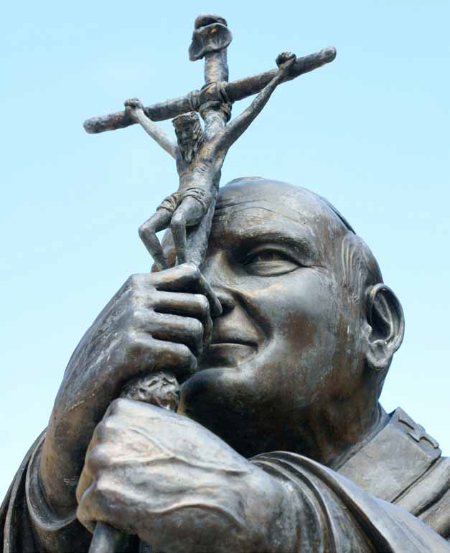
As God’s chosen ones, holy and beloved, clothe yourselves with compassion, kindness, humility, meekness, and patience.
Put up with one another and, if anyone has a complaint against another, forgive one another; just as the Lord has forgiven you, so you also must forgive.
Above all, clothe yourselves with love, which binds everything together in perfect harmony.
And let the peace of Christ rule in your hearts, that is why you belong to the Christian family.
And always be thankful.
Based on Colossians 3: 12-15
(Come and See)

Slide 3
Some questions
Did anything impress you in this story?
Which of the words in St Paul would you think describes the Pope’s action?
What are the reconciliation words that Paul mentions?
How did Pope John Paul II build a bridge?
How does Paul suggest we can build bridges when we fail in Jesus’ commandment?
If you have fallen out with a good friend what could you do to reach out to them, to build a bridge towards them?

